Slide 1

Software requirements (swr302)
A picture is worth 1024 words
(chapter 12)

Slide 2
Overview
A useful of picture in requirements representation
Diagrams communicate certain types of information more efficiently than text can.
Pictures help bridge language and vocabulary barriers among team members
Modeling the requirements
Visual requirements models can help you identify missing, extraneous, and inconsistent requirements.
Given the limitations of human short-term memory, analyzing a list of one thousand requirements for inconsistencies, duplication, and extraneous requirements is nearly impossible.

Slide 3
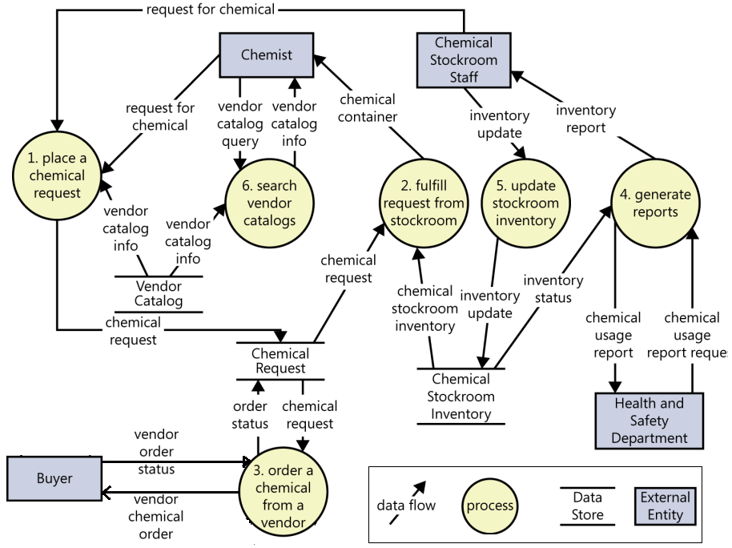
Data flow diagram (DFD)
Notes:
Purpose
DFDs provide a big-picture view of how data moves through a system, which other models don’t show well
A DFD gives context to the functional requirements regarding how the user performs specific tasks.
DFDs can be used as a technique to identify missing data requirements

Slide 4
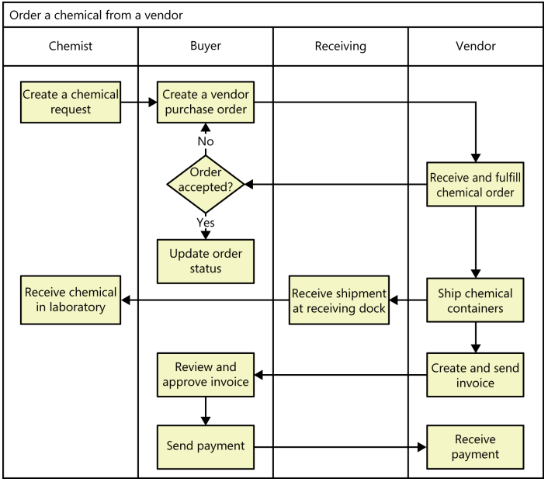
Swimlane diagram
Notes:
Purpose:
Provide a way to represent the steps involved in a business process or the operations of a proposed software system.
They are a variation of flowcharts, subdivided into visual subcomponents called lanes. The lanes can represent different systems or actors that execute the steps in the process.
Swimlane diagrams are most commonly used to show business processes, workflows, or system and user interactions.
They are similar to UML activity diagrams. Swimlane diagrams are sometimes called cross-functional diagrams.

Slide 5
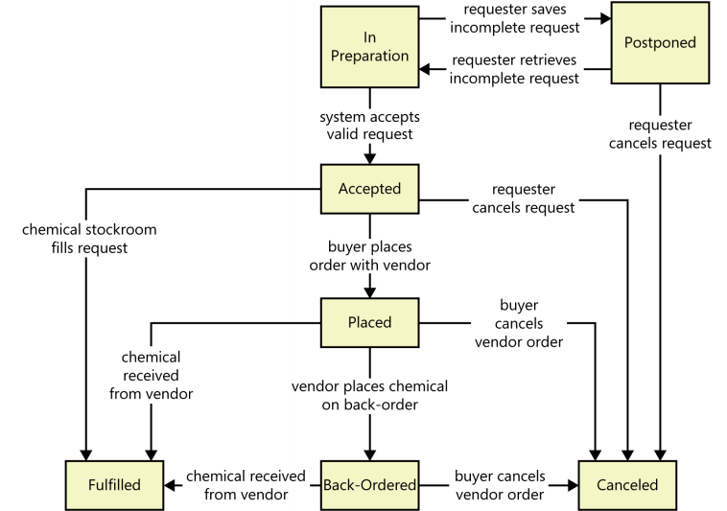
State-transition diagram
Notes:
Purpose: Software systems involve a combination of functional behavior, data manipulation, and state changes. Real-time systems and process control applications can exist in one of a limited number of states at any given time.
A state change can take place only when well-defined criteria are satisfied, such as receiving a specific input stimulus under certain conditions
State transition diagram contains three type of elements:
Possible system states, shown as rectangles
Allowed state changes or transitions, shown as arrows connecting pairs of rectangles
Events or conditions that cause each transition to take place, shown as text labels on each transition arrow

Slide 6
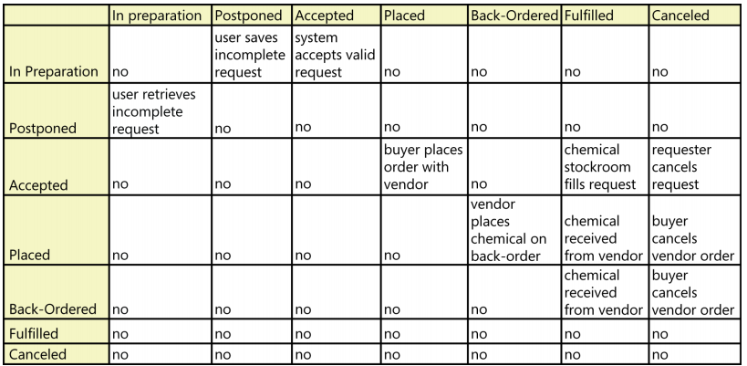
State-transition diagram
A state table shows all of the possible transitions between states in the form of a matrix. A business analyst can use state tables to ensure that all transitions are identified by analyzing every cell in the matrix. All states are written down the first column and repeated across the first row of the table

Slide 7
Others for self-studying
Modeling techniques
Dialog map
Decision tables and decision trees
Event-response tables
UML diagrams
Modeling on agile projects

Slide 8
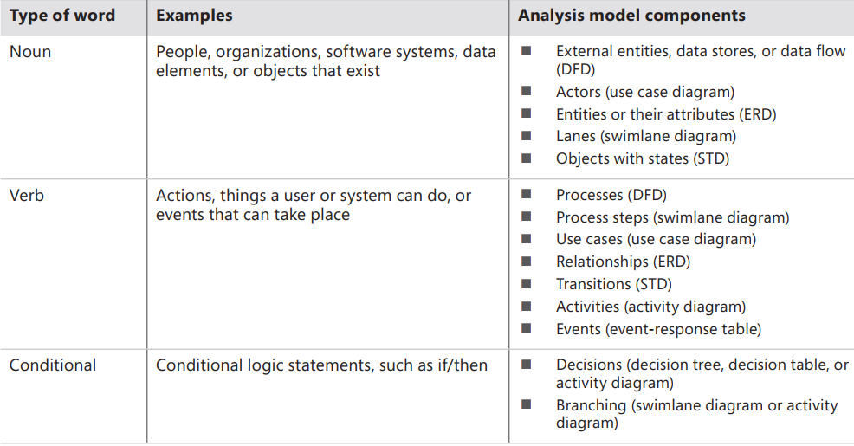
Diagraming & Modelling
From voice of the customer to analysis models
Notes:
By listening carefully to how customers present their requirements, the BA can pick out keywords that translate into specific model elements

Slide 9
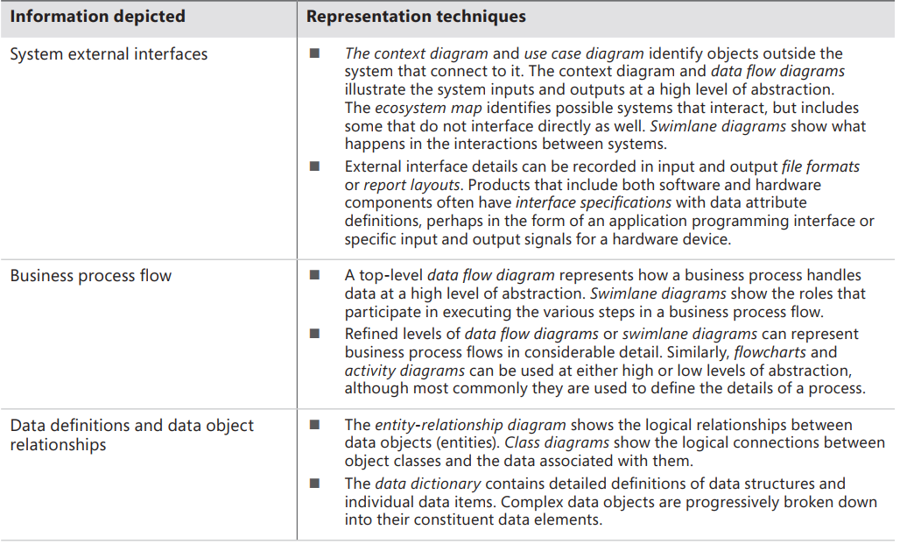
Diagraming & Modelling
Selecting the right representations 1/3

Slide 10
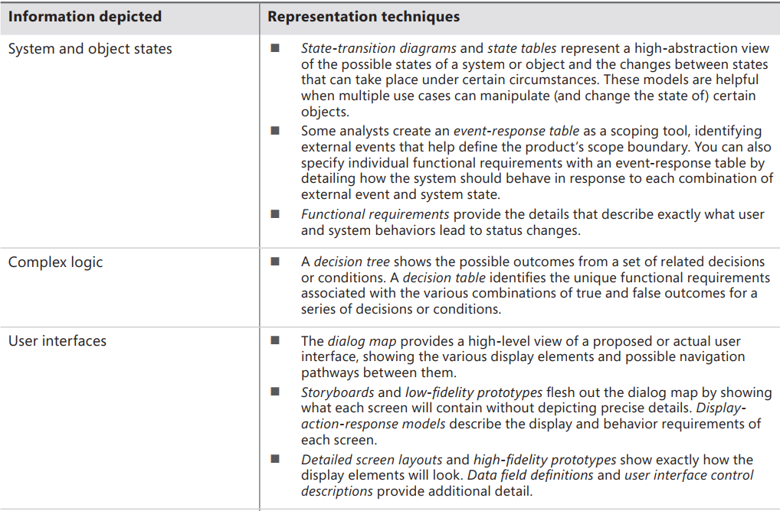
Diagraming & Modelling
Selecting the right representations 2/3

Slide 11
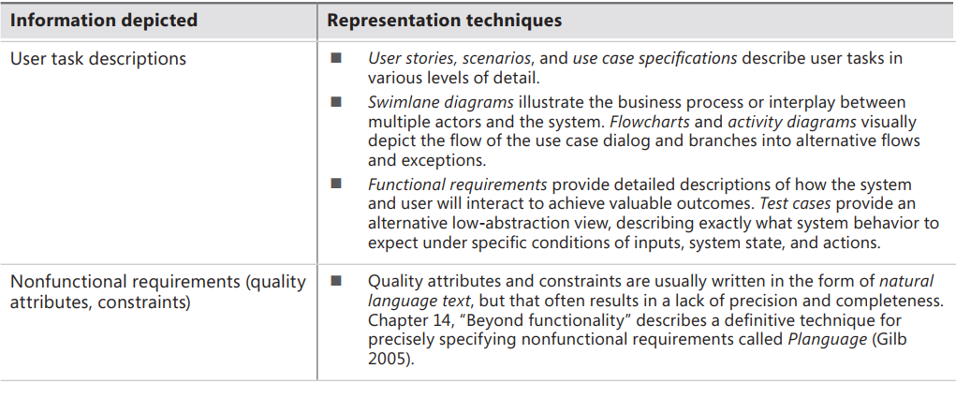
Diagraming & Modelling
Selecting the right representations 3/3

Slide 12


